Slide 1
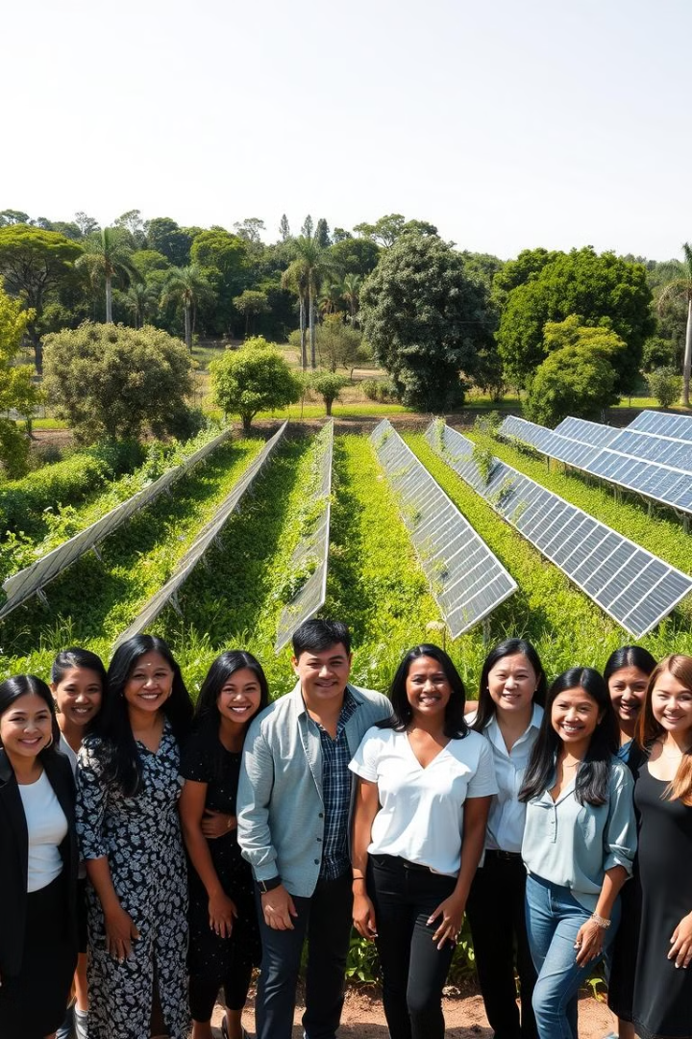
Blogging Platform
Briefly introduce the project’s aim to provide a user-friendly platform where authors create and share blog posts while readers engage through reading and commenting.

Slide 2
Project Abstract
Overview
Key Objectives
Approach
This project combines innovative renewable energy technologies, large-scale reforestation efforts, and community-driven initiatives to create a comprehensive solution to address climate change.
To provide a seamless platform for authors to publish quality content.
To engage readers through an intuitive interface that supports interaction and comments.
Define objectives, design a responsive UI, build backend with MongoDB, Node.js, and Express, connect frontend in React, test thoroughly, deploy on cloud, and maintain regularly.

Slide 3

Project Goals and Objectives
Main Goals:
1
Develop a secure and scalable platform for content creation and readership.
Enhance user experience with a clean, responsive UI.
Specific Objectives:
Implement authentication and user roles (author and reader).
Allow content categorization and tagging for easier navigation.
Integrate analytics for tracking engagement
2

Slide 4
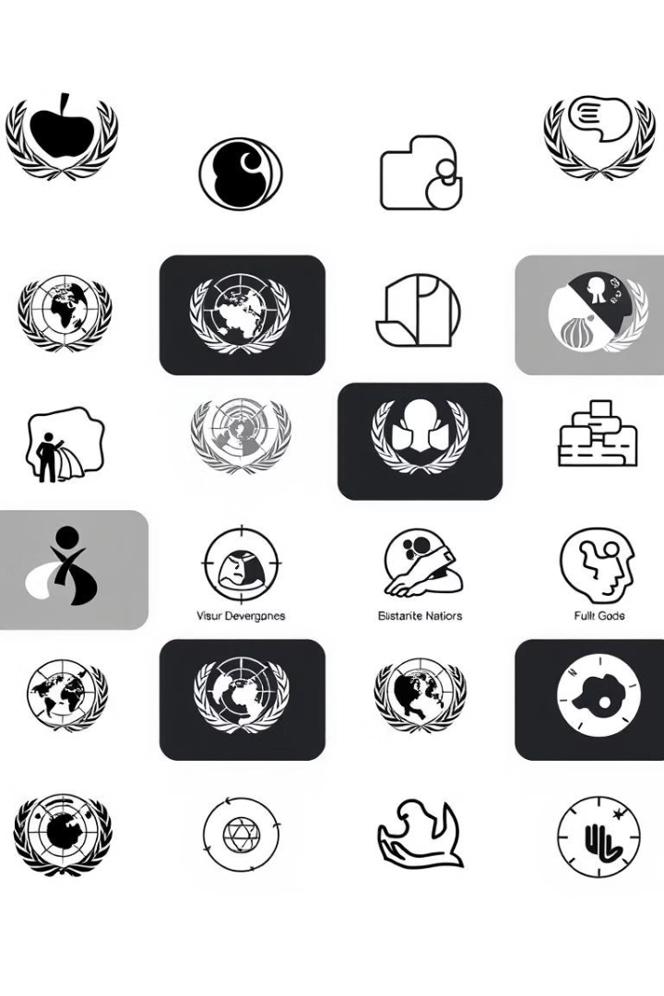
Alignment with UN Sustainable Development Goals (SDGs)
SDG 4:Quality Education
SDG 9: Industry, Innovation,
and Infrastructure
Increase the share of renewable energy in the global energy mix.
Using the MERN stack aligns with modern technology infrastructures.
SDG 10: Reduced Inequalities
Accessible to a wide audience regardless of geographic or socioeconomic status.

Slide 5

Methodology and Approach
Technology Stack:
MongoDB: NoSQL database for storing user and blog data.
Express.js and Node.js: Backend for handling user requests and data interactions.
React: Frontend for creating an interactive user experience.
Development Approach:
Agile methodology with iterative development and frequent updates.
Focus on modular and reusable components for scalability.

Slide 6


Expected Outcomes and Impact
Expected Outcomes
Impact:
A fully functional, user-friendly blogging website with distinct author and reader interfaces.
High engagement through a responsive and interactive design.
Empower authors to share insights, potentially reaching a global audience.
Foster a community of knowledge-sharing and discussion.

Slide 7

Key Project Deliverables
Phase 1:
Basic layout, user authentication, and role assignment.
Author dashboard, blog creation, and reader browsing features.
Phase 2:

Slide 8

Next Steps and Conclusion
1
Next Steps:
2
Contribution:
Testing phase for functionality and user experience.
Deploying the application for live user testing.
Gathering feedback for continuous improvements.
Open-source code contributions are encouraged to refine and expand functionality.
Inviting user feedback to ensure the platform meets user needs effectively.

